Slide 1
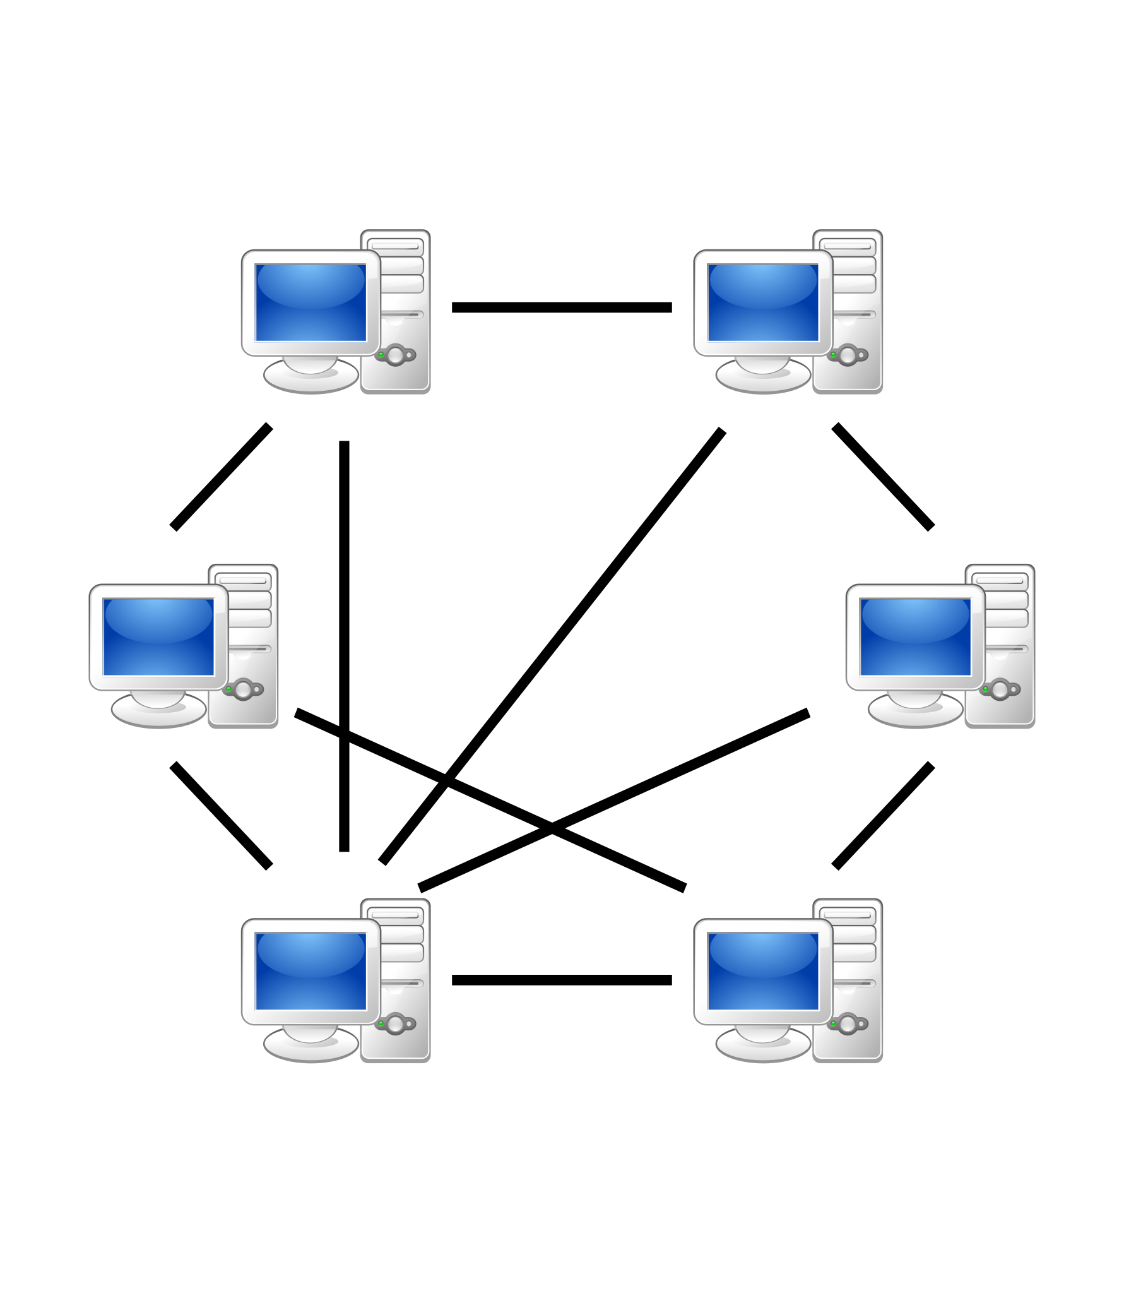
Chat-Room Based File Transfer Application
Pratikshay Awadhoot Avanti Nipunge Abhishek Savaliya Myna Nereti
Date: 04/27/2025

Slide 2
Agenda
Abstract
Problem Statement
Improved Solution
System Structure & Implementation
Results
Conclusion & Future Work

Slide 3
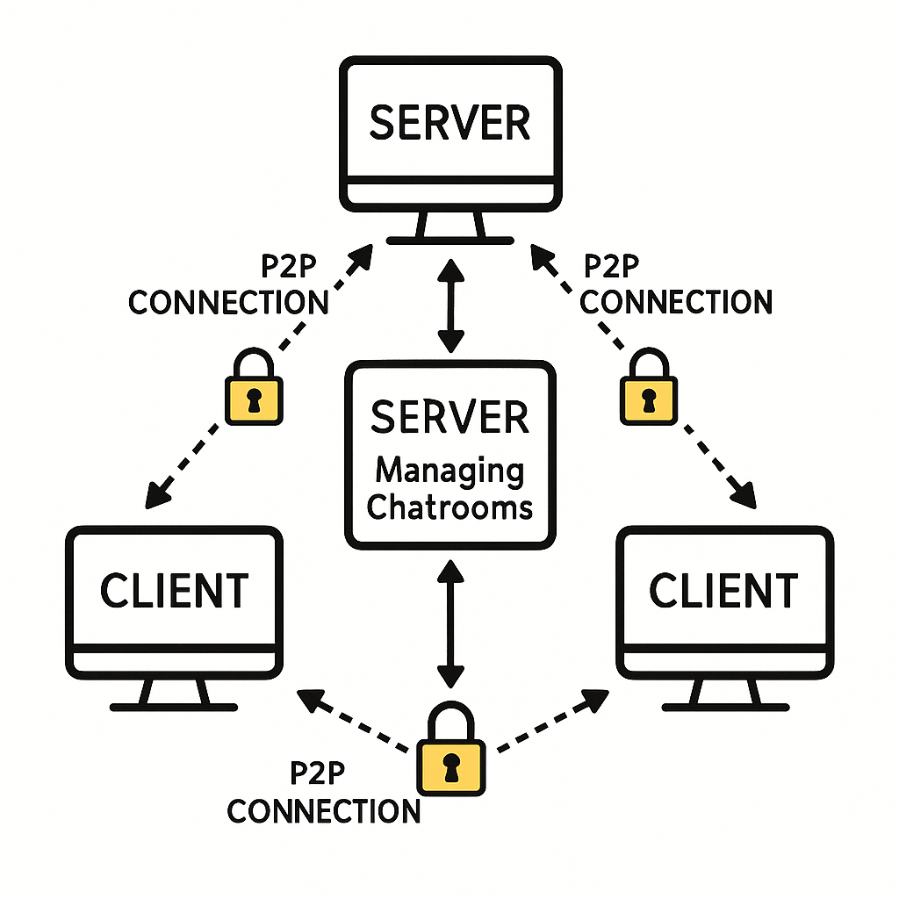
Abstraction
In this project we’ll build a secure, decentralized CLI chat application
Where users can create and join named chatrooms on a central server, but all file transfers (and optional private messages) happen peer-to-peer.
Each client will receive an AES session key via an RSA handshake with the server, ensuring end-to-end encryption
Then use direct P2P connections for fast, server-free file delivery scoped strictly to room members.
Cached
Cached
Notes:
In large-scale distributed systems, multiple services and processes must coordinate access to shared resources (like configuration data or critical operations). Without a centralized mechanism, these systems can face issues like conflicting updates, data inconsistency, and difficulty in leader election. Google needed a reliable way to manage these challenges across its internal infrastructure.

Slide 4
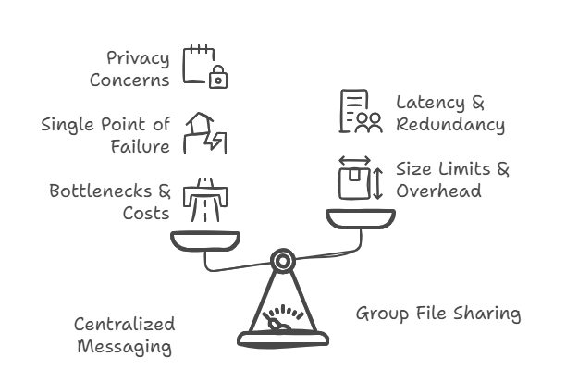
Problem Statement
Centralized Group Messaging
Uses a single or clustered server farm to relay every message and file.
Bottlenecks & Costs: As group size and file sizes grow, servers must handle enormous bandwidth and storage.
Single Point of Failure: Outages or attacks on the server infrastructure halt all communication.
Privacy Concerns: Even with end-to-end encryption, metadata (timestamps, group membership, file sizes) passes through the provider’s servers.
Group File Sharing Limitations
Size Limits: Many apps cap file sizes (e.g. 100 MB), forcing third-party services.
Storage Overhead: Each file is stored on the provider’s disk, then re-fetched by every participant.
Latency & Redundancy: Every download incurs extra hops user → server → each peer adding delay and wasting upstream bandwidth.
Notes:
Designed for loosely coupled distributed systems with many small machines connected via a highspeed network.
A Chubby cell can serve 10,000+ machines connected by 1Gbit/s Ethernet. Most Chubby cells operate within a single data center, though some have geographically distributed replicas.
Helps clients synchronize activities and agree on shared information in distributed environments. Primary goals include reliability, availability, and simple semantics.
Supports wholefile reads & writes. Includes advisory locks and event notifications (e.g., file modifications).
Used for leader election in distributed systems (e.g., Google File System (GFS) and Bigtable). Acts as a centralized metadata store, making it the root of distributed data structures.
Before Chubby, Google used ad hoc methods or manual intervention for leader election. Chubby improved availability by automating this process.
Ensures asynchronous consensus despite network delays, packet loss, or reordering. Paxos is at the core of all reliable consensus protocols in distributed systems.
Not a Research Project, but an Engineering Solution
Chubby was built to solve practical engineering problems at Google. No new algorithms were introduced; instead, it applied existing distributed computing principles effectively.
Impact on Distributed Computing at Google
Reduced computing effort by replacing inefficient leader election methods. Enabled fault tolerance and reliability by removing reliance on human intervention.
Lessons & Evolution Over Time
The design evolved based on realworld use. Some features were unexpectedly useful, while others proved to be mistakes. Certain details, like consensus protocols or RPC systems, were omitted since they were well documented elsewhere.

Slide 5




Solution
Hybrid Architecture
Client–Server for chatroom & membership management.
Peer-to-Peer for all file transfers (and optional private messaging).
Scoped Rooms
Users create or join named chatrooms.
Only members of that room see its messages and files.
Security
RSA for secure handshake and AES key distribution.
AES for fast, symmetric encryption of messages & files
CLI Interface
Lightweight, scriptable, cross-platform (Linux/WSL).
Notes:
Reliable Storage (Central Bulletin Board)
Restaurant Analogy: The restaurant uses a central bulletin board to track reservations, table statuses, and special orders. This board must be reliable, if it crashes or loses data, chaos ensues (e.g., double bookings).
Technical Term: Chubby acts as a distributed, fault tolerant storage system, ensuring data (like configuration files or locks) is consistently available even if individual servers fail. Think of it as a distributed key value store with strong consistency guarantees.
Coarse-Grained Locking (Reserving the Private Dining Room)
Restaurant Analogy: When a large group reserves the private dining room, the host places a "RESERVED" sign on the room’s slot on the bulletin board. This lock is coarse-grained, it’s held for hours (the entire dinner duration), not just seconds. Other staff see the sign and avoid booking the room during that time.
Technical Term: Chubby provides long-lived locks (e.g., minutes/hours) for systemwide tasks like leader election or configuration updates. For example, a distributed database might use a Chubby lock to ensure only one node acts as the primary writer at a time.
Advisory Locks (Kitchen Order Tickets)
Restaurant Analogy: The kitchen uses a ticket system to manage orders. When Chef Alice takes a ticket to prepare "Table 5’s Steak," others voluntarily avoid working on that order. The lock is advisory nothing physically stops Chef Bob from grabbing the ticket, but the team cooperates.
Technical Term: Chubby’s locks are advisory, Chubby locks are "advisory" which means they rely on clients to cooperate and not access a resource while another client holds the lock, but they don't enforce access restrictions strictly.

Slide 6
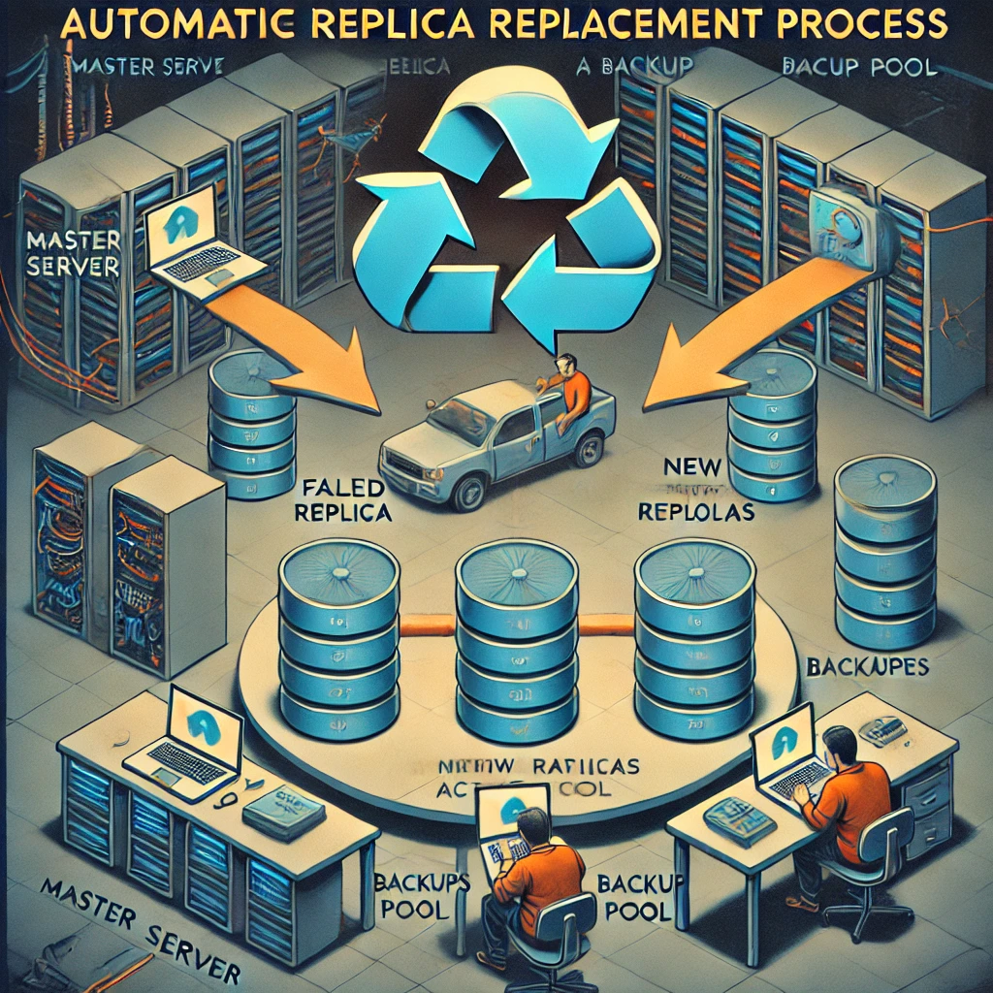
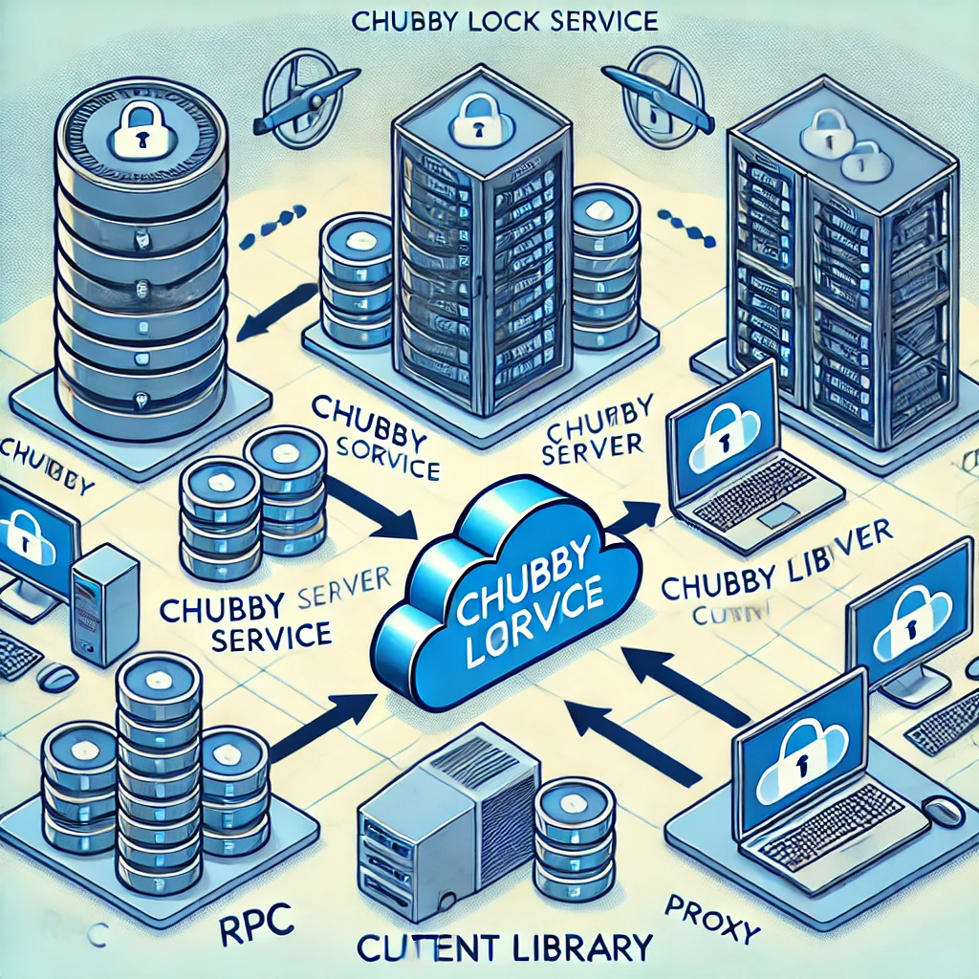
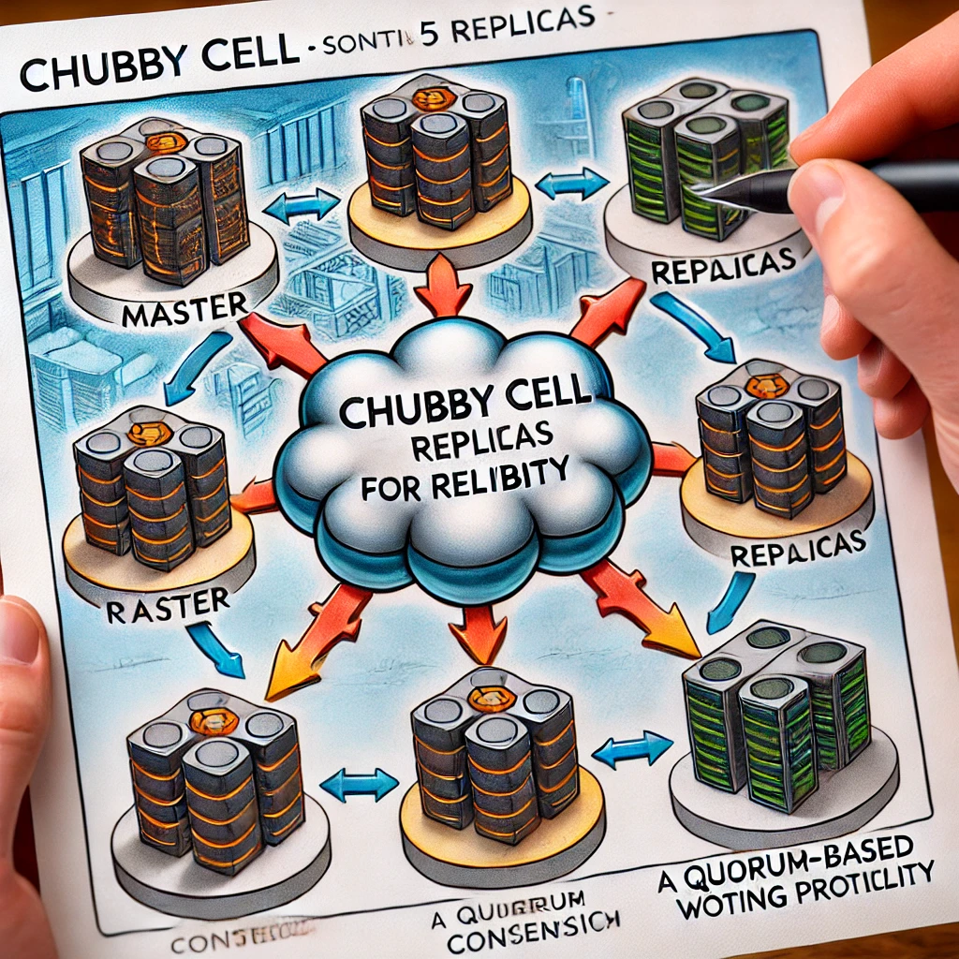
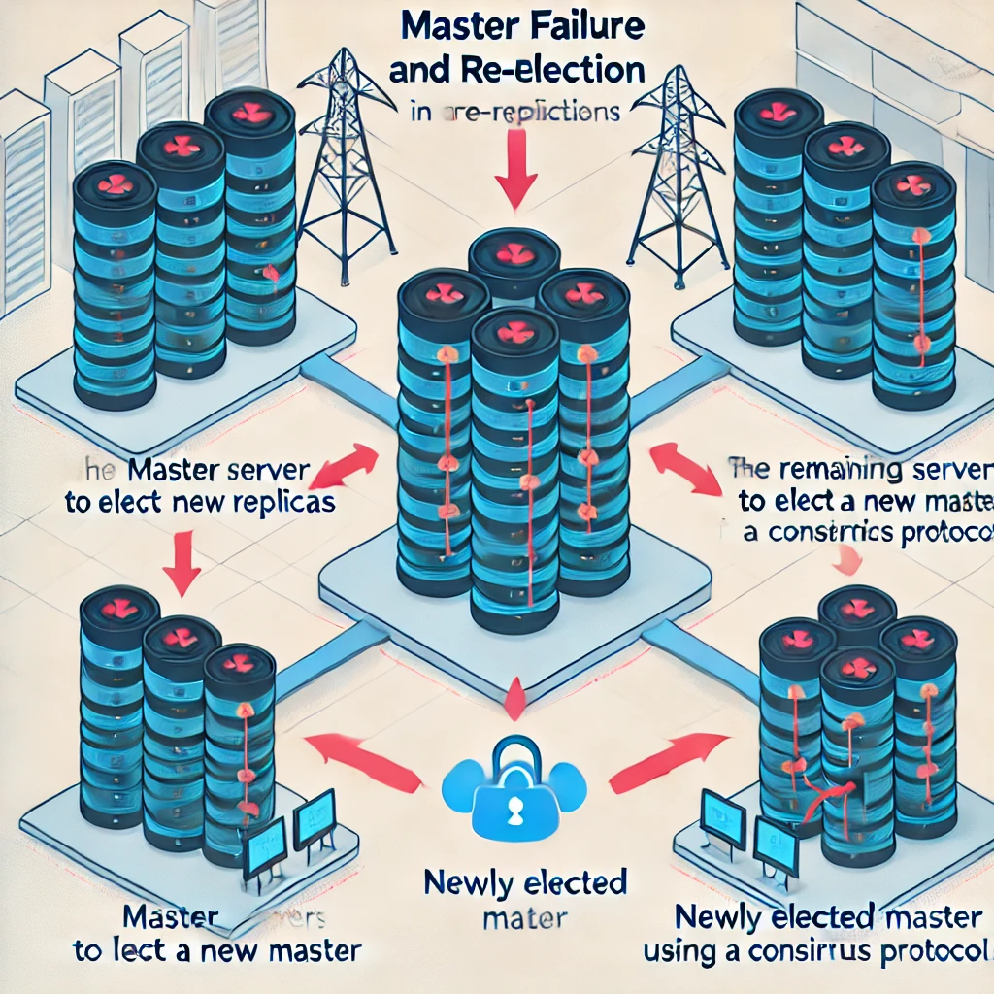
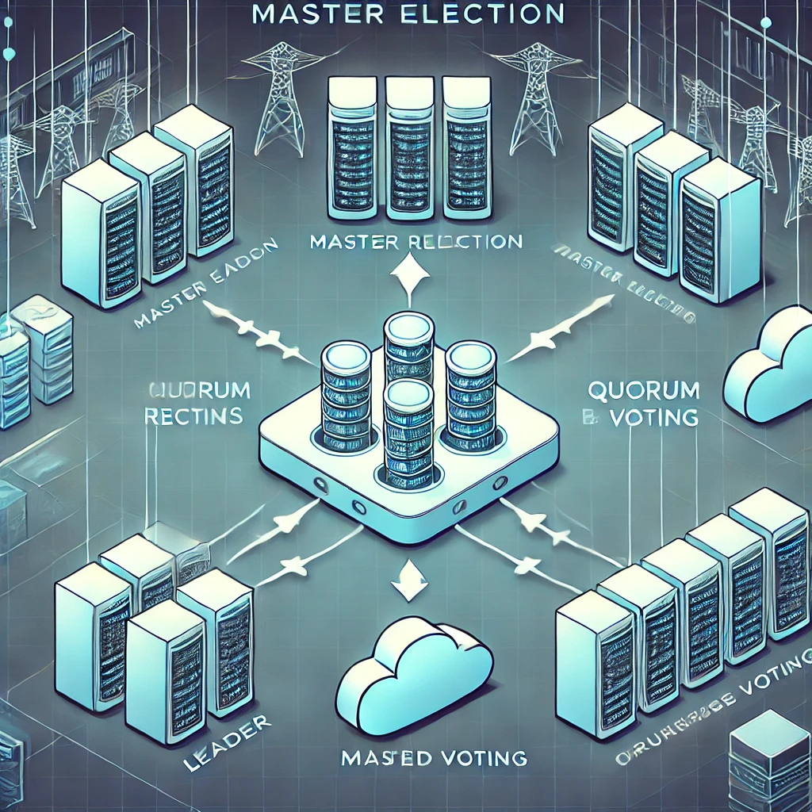
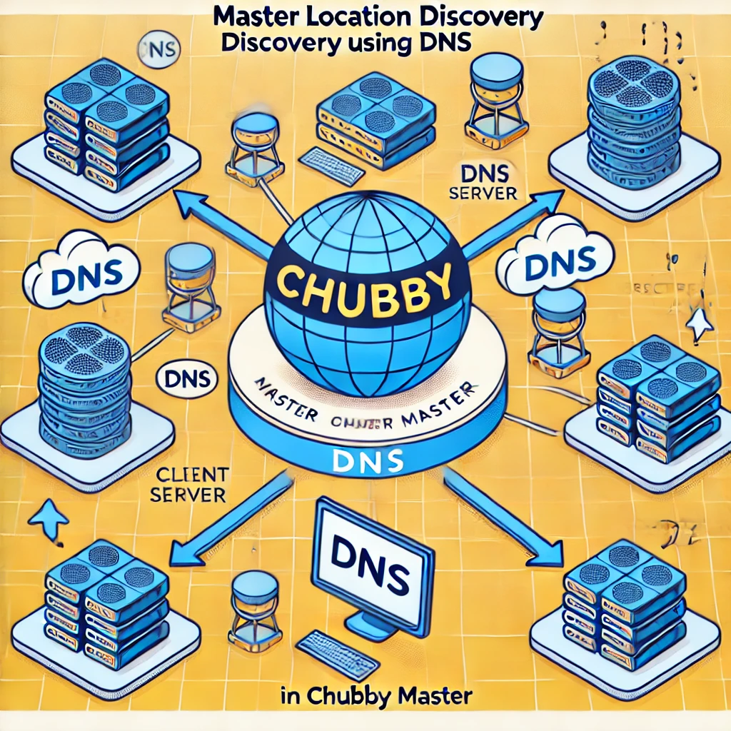
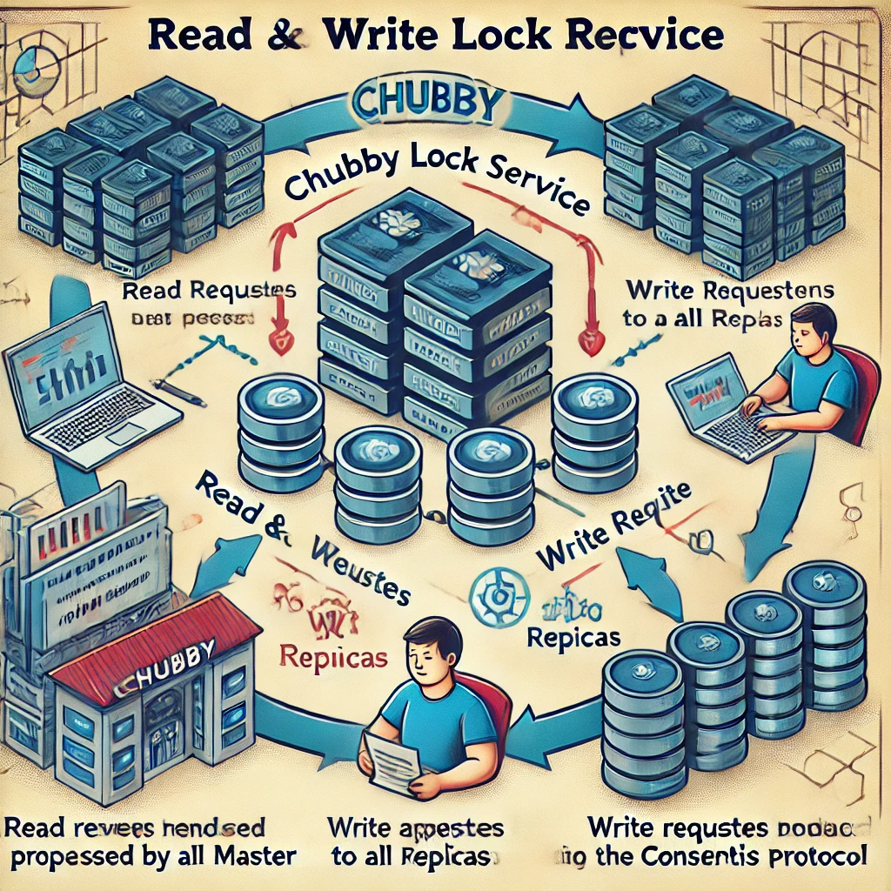
System Structure & Implementation

Slide 7
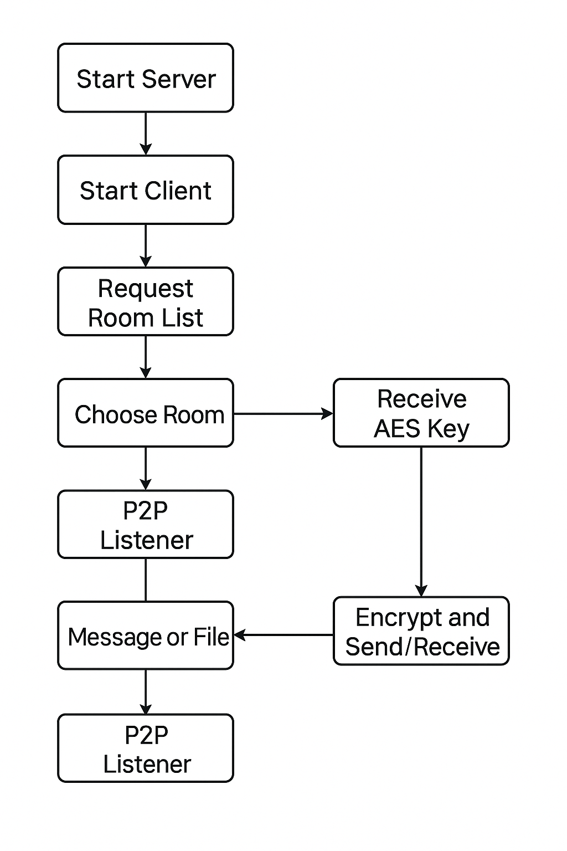
System Structure
Notes:
The diagram shows a Chubby cell with five servers, one of which is the master.
Each client process includes a Chubby library.
The library communicates with the Chubby cell via RPC calls.
The master handles most requests and coordinates with replicas.
This setup ensures consistent, fault-tolerant coordination for distributed applications.

Slide 8
Environment & Project Layout
WSL / Linux with GCC, OpenSSL, pthreads
Directory structure
include/
common.h
src/
main.c : mode selector (server vs client)
server.c : chatroom & key‐exchange server
client.c : CLI, P2P orchestration
p2p.c : direct send/receive of messages & files
encryption.c : RSA/AES helpers
Makefile: build “build/chatapp”
Implementation
Notes:
Chubby’s server-client architecture (optionally using a proxy) hides complex consensus details, making distributed coordination simpler for developers.

Slide 9
Startup:
Generate single static AES key & IV for all rooms
Listen on TCP port 8888
Client registration:
Assign client_number, record IP & P2P port
Exchange RSA public key
RSA‐encrypt AES key/IV and send for session
Chatroom commands (in handle_client):
/createroom <name> → create Chatroom entry
/listrooms → returns IDs + names
/joinroom <id>, /leaveroom <id> → mutate rooms[id].members[]
/listmembers <id> → send back ClientInfo of each member
Implementation
Notes:
Chubby’s five-replica cell design ensures fault tolerance and continuous operation by requiring a majority (3 of 5) to agree, with replicas spread across racks to reduce correlated failures.

Slide 10
Client Implementation (Part 1)
Mode selection in main.c: enforced choices “1” or “2”
Client startup (start_client):
Connect to server, receive client_number
Send chosen P2P port = P2P_PORT_BASE + client_number
Generate/Load RSA keypair (PEM files)
Send public‐key PEM, receive RSA‐encrypted AES key & IV
Decrypt with private key → now have aes_key & aes_iv
Implementation
Notes:
Chubby elects a single master via distributed consensus with a majority vote and master lease, preventing split-brain and ensuring data consistency and fault tolerance.
and once a candidate receives a majority of votes, it is elected and granted a master lease, ensuring it remains the sole master until its lease expires, The replicas vote based on each candidate’s current state and ability to serve reliably—aspects like responsiveness, data freshness, and overall health

Slide 11
Client Implementation (Part 2)
P2P listener thread:
p2p_listener_thread(port) binds & accepts peers
Reads “MSG” or “FILE” frames, decrypts with AES, writes to stdout or file
CLI loop (commands):
Chatroom: /listrooms, /createroom, /joinroom, /leaveroom, /listmembers
Scoped P2P: /msg, /broadcast, /sendfile, /sendfilegroup
current_room tracks which room you’re in
Implementation

Slide 12
P2P Module (p2p.c)
Frames:
“MSG”: 3-byte header + 4-byte length + encrypted payload
“FILE”: 4-byte header + 4-byte length + payload (filename + file data)
send_message_to_peer(ip,port,msg):
AES-encrypt text → send with “MSG” frame
send_file_to_peer(ip,port,filename):
Read file → AES-encrypt → frame with filename length & bytes
Implementation

Slide 13
Encryption Module (encryption.c)
RSA
generate_rsa_keys(pub.pem,priv.pem)
rsa_encrypt_mem() / rsa_decrypt_file() for small blobs
AES-CFB128
generate_aes_key(key,iv) uses RAND_bytes
aes_encrypt() / aes_decrypt() use OpenSSL’s AES_cfb128_encrypt
Key Exchange Workflow
Server generates static AES per‐room
Client sends RSA public key to server
Server RSA-encrypts AES key & IV → client decrypts
Implementation

Slide 14
Testing
Phase 1: Chatroom create/join/list & basic messaging
Phase 2: P2P file transfer works across 2+ clients
Phase 3: RSA + AES end-to-end encryption verified
Phase 4: UI checks, usage hints, error handling
Implementation

Slide 15
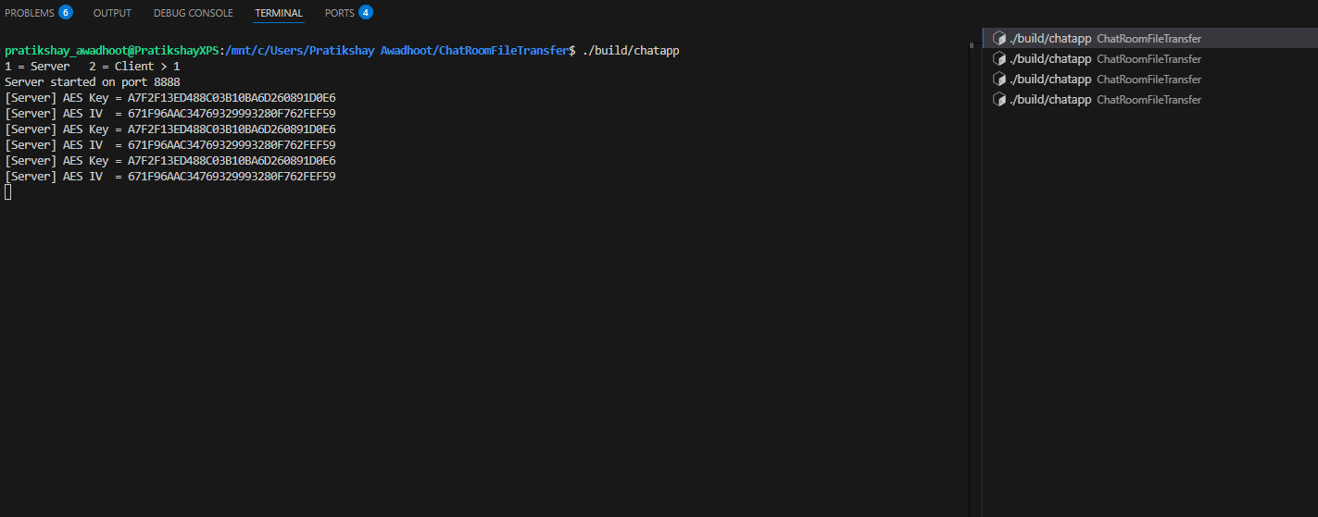
Results & Demo
System Structure
Hosting server for peer management and providing keys
Notes:
Files, Directories, and Handles
Chubby provides a simple tree-based file system for metadata storage. Each file or directory has a unique path (like in UNIX). But Chubby simplifies things for distributed systems:
No moving files between directories.
No symbolic links.
No last-access timestamps.
These choices make it easier to cache data across thousands of clients. Files can be permanent or ephemeral or transient (temporary files that disappear if no one is using them). To access a file, clients get a handle — like a file descriptor, but with extra protections to prevent tampering.

Slide 16
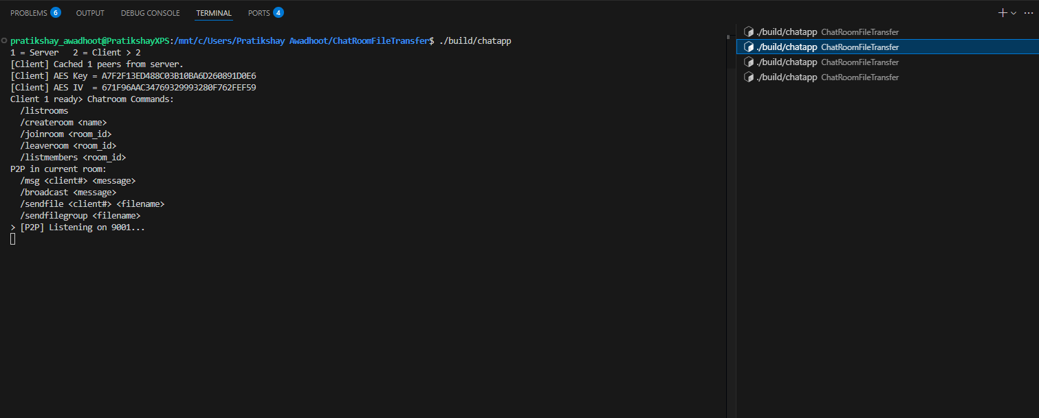

Results & Demo
System Structure
Client 1 on separate terminal
Notes:
Files, Directories, and Handles
Chubby provides a simple tree-based file system for metadata storage. Each file or directory has a unique path (like in UNIX). But Chubby simplifies things for distributed systems:
No moving files between directories.
No symbolic links.
No last-access timestamps.
These choices make it easier to cache data across thousands of clients. Files can be permanent or ephemeral or transient (temporary files that disappear if no one is using them). To access a file, clients get a handle — like a file descriptor, but with extra protections to prevent tampering.

Slide 17
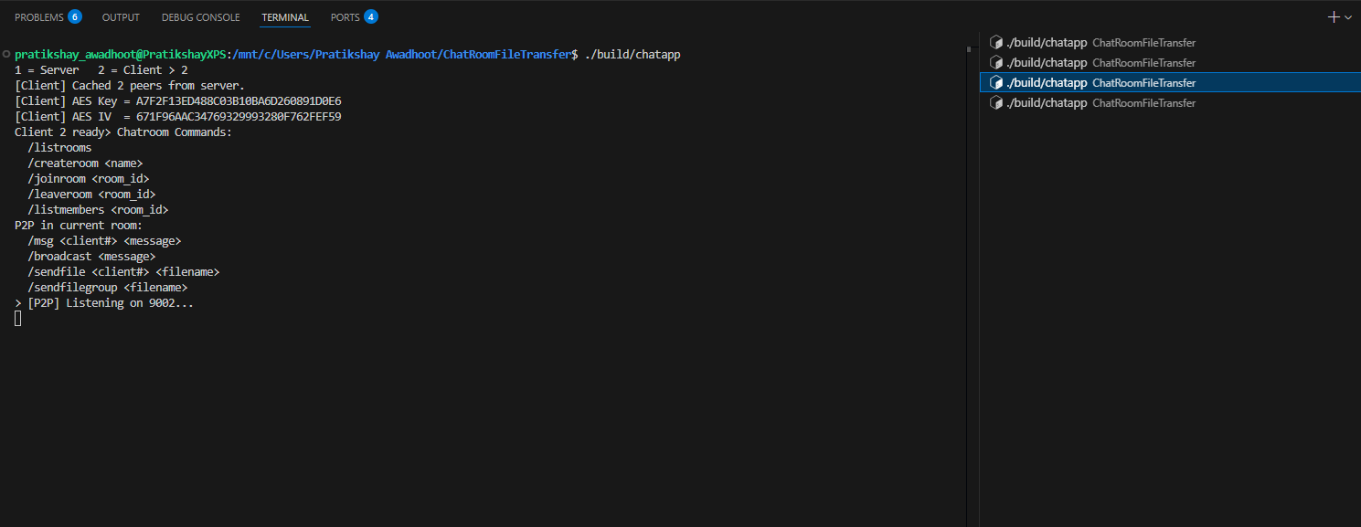
Results & Demo
System Structure
Client 2 on separate terminal
Notes:
Files, Directories, and Handles
Chubby provides a simple tree-based file system for metadata storage. Each file or directory has a unique path (like in UNIX). But Chubby simplifies things for distributed systems:
No moving files between directories.
No symbolic links.
No last-access timestamps.
These choices make it easier to cache data across thousands of clients. Files can be permanent or ephemeral or transient (temporary files that disappear if no one is using them). To access a file, clients get a handle — like a file descriptor, but with extra protections to prevent tampering.

Slide 18
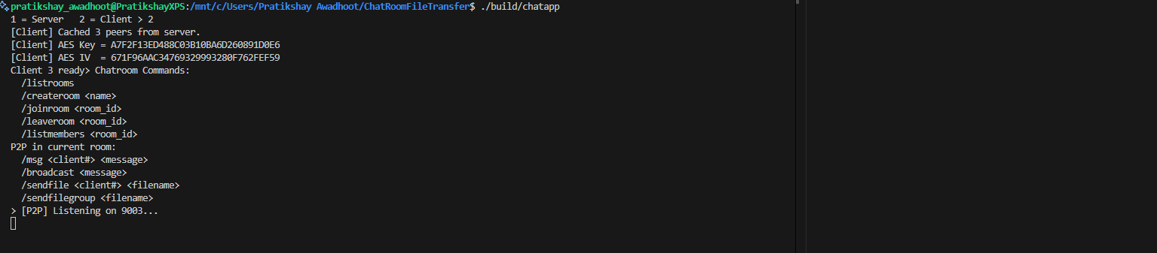
Results & Demo
System Structure
Client 3 on separate terminal
Notes:
Files, Directories, and Handles
Chubby provides a simple tree-based file system for metadata storage. Each file or directory has a unique path (like in UNIX). But Chubby simplifies things for distributed systems:
No moving files between directories.
No symbolic links.
No last-access timestamps.
These choices make it easier to cache data across thousands of clients. Files can be permanent or ephemeral or transient (temporary files that disappear if no one is using them). To access a file, clients get a handle — like a file descriptor, but with extra protections to prevent tampering.

Slide 19
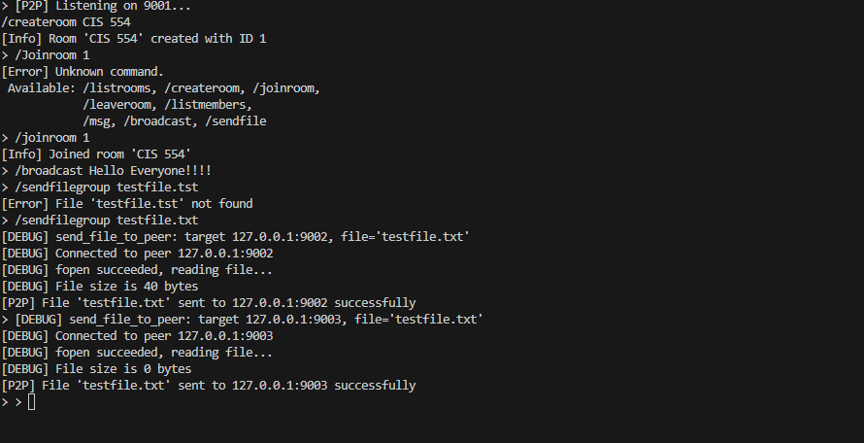
Results & Demo
System Structure
Client 1: Creating room, broadcasting messages and sending file
Notes:
Files, Directories, and Handles
Chubby provides a simple tree-based file system for metadata storage. Each file or directory has a unique path (like in UNIX). But Chubby simplifies things for distributed systems:
No moving files between directories.
No symbolic links.
No last-access timestamps.
These choices make it easier to cache data across thousands of clients. Files can be permanent or ephemeral or transient (temporary files that disappear if no one is using them). To access a file, clients get a handle — like a file descriptor, but with extra protections to prevent tampering.

Slide 20
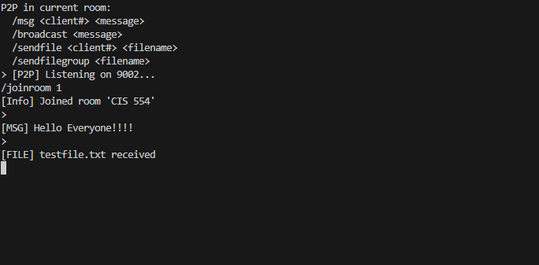
Results & Demo
System Structure
Successfully received on client 2
Notes:
Files, Directories, and Handles
Chubby provides a simple tree-based file system for metadata storage. Each file or directory has a unique path (like in UNIX). But Chubby simplifies things for distributed systems:
No moving files between directories.
No symbolic links.
No last-access timestamps.
These choices make it easier to cache data across thousands of clients. Files can be permanent or ephemeral or transient (temporary files that disappear if no one is using them). To access a file, clients get a handle — like a file descriptor, but with extra protections to prevent tampering.

Slide 21
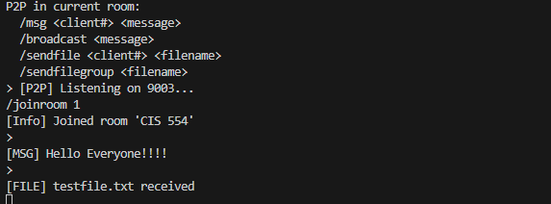
Results & Demo
System Structure
Successfully received on client 3
Notes:
Files, Directories, and Handles
Chubby provides a simple tree-based file system for metadata storage. Each file or directory has a unique path (like in UNIX). But Chubby simplifies things for distributed systems:
No moving files between directories.
No symbolic links.
No last-access timestamps.
These choices make it easier to cache data across thousands of clients. Files can be permanent or ephemeral or transient (temporary files that disappear if no one is using them). To access a file, clients get a handle — like a file descriptor, but with extra protections to prevent tampering.

Slide 22
Conclusion and Future work
Conclusion
Merged the best of centralized chatrooms (easy discovery, membership) with P2P file delivery (scalable, resilient, private).
Achieved WhatsApp-like group UX with true peer-scoped transfers and end-to-end encryption.
Future Enhancements
GUI or TUI front-end.
NAT traversal (STUN/TURN) for peers behind firewalls.
Persistent offline file queueing for intermittent peers.
Notes:
5. Design Advice and Early Testing
Rob Pike, Sean Quinlan, and Sanjay Ghemawat provided valuable design input, refining Chubby’s architecture. Many Google developers helped identify and fix early weaknesses, ensuring Chubby’s robustness in production.
"Over time, Chubby evolved from a lock service into Google’s primary name service.""It plays a crucial role in GFS, Bigtable, and MapReduce for leader election and synchronization.""Scalability improvements included:"Client-side caching
Protocol conversion
Load adaptation
"Several Google engineers contributed to Chubby’s development, including Sharon Perl, Tushar Chandra, and Robert Griesemer.""Rob Pike, Sanjay Ghemawat, and Sean Quinlan played crucial roles in refining Chubby’s system design and architecture."

Slide 23




Thank you
Any Question?
Image Generated By DALL. E, Icons by Flaticon

